Slide 1
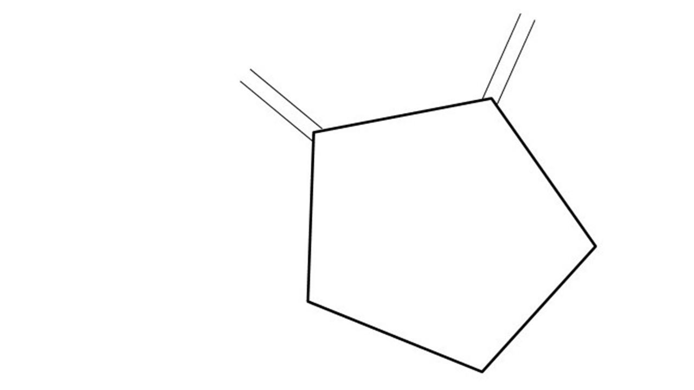


Great Cow BASIC Part 15
Great Cow BASIC for the PIC16F171xx chip Family
Oct 2022

Slide 2
Videos...
Install the hardware and make the board work – three LED programs
Make four LEDs flash in a sequence
Set the LEDs to represent the value of ADC
Sequence the LEDs with a delay using the value of ADC
Using an input to set the state of the LED
Using the reset switch
Using the switch, ADC – the LEDs flash in a sequence with reverse
Using the serial to display values
Using the timer0 overflow, 8bit timer, 16bit timer to flash the LEDs
Using CCP/PWM to dim the LEDS
Using I²C with serial to discover I2C devices
Using EEProm – showing values on the serial terminal
Using an I²C GCLD display
Using an SPI GCLD display
Using PWM to dim the LEDS
Using memory within the PIC – Progmem and SAF memory
The Great Cow BASIC tool chain
Assembly and alternatives assemblers
Summary

Slide 3
Great Cow BASIC Compiler
Great Cow BASIC is an Open Source compiler for Microchip PIC &AVR and Logic Green AVR microcontrollers
Great Cow BASIC now supports the 16F171xx chip family
Great Cow BASIC Compiler

Slide 4
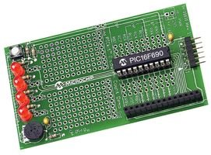
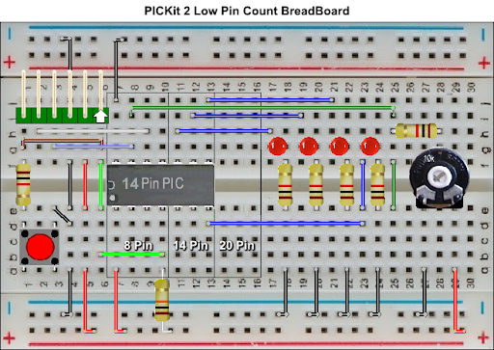

Hardware
Microchip Low Pin Count Demo Board
PICKit_2_Low_Pin_Count_User_Guide_51556a.pdf
By Chris Roper

Slide 5
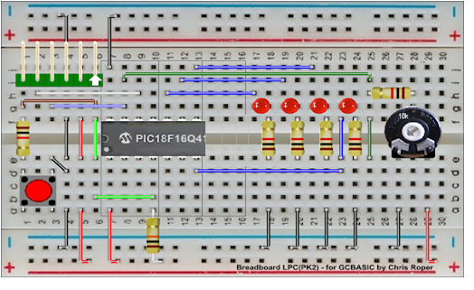
Hardware
Layout
16F17126
By Chris Roper

Slide 6
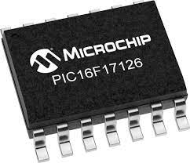
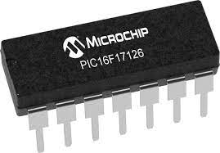
PIC16F171xx
PIC16F171xx is a high performance PIC16
Digital and Analog peripherals
12-bit ADC
Multiple communication interfaces
Serial, I2C, SPI
PWM – CCP/PWM and 16Bit
Configurable Logic Cells
OpAmp
The PIC16F171xx offers 8 to 20 pin products in small footprint packages to support customers in a variety of space constrained and sensor node applications.

Slide 8
Pulse Width Modulation
Pulse Width Modulation ( PWM ) is simply a succession of pulses – is a method of reducing the average power delivered by an electrical signal, by effectively chopping it up into discrete parts.
The average value of voltage (and current) fed to the load is controlled by turning on and off at a fast rate. The longer the signal is on compared to the off periods, the higher the total power supplied to the load.

Slide 9
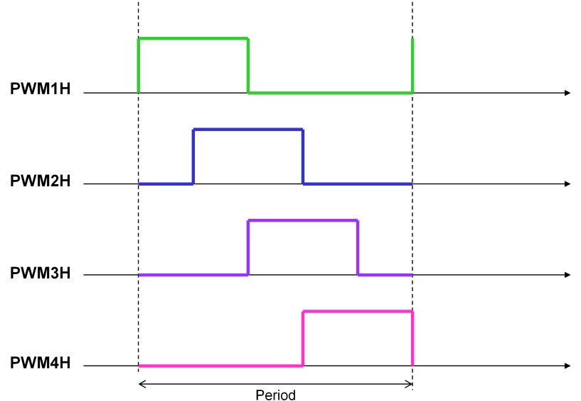
16 Bit Pulse Width Modulation
Five main operating modes: 1 Left Aligned
2 Right Aligned 3 Center-Aligned 4 Variable Aligned 5 Compare • Pulsed • Toggled • Push-pull operation (available in Left and Right Aligned modes only) • Independent 16-bit period timer • Programmable clock sources • Programmable trigger sources for synchronous duty cycle and period changes • Programmable synchronous/asynchronous Reset sources • Programmable Reset source polarity control • Programmable PWM output polarity control • Up to four two-output slices per modue

Slide 10
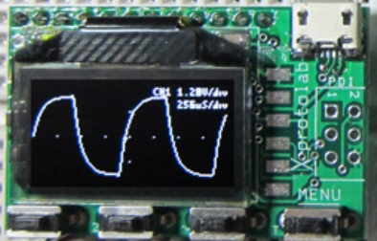
Hardware
http://www.gabotronics.com/development-boards/xmega-xminilab.htm
16F17126

Slide 11
PWM
 | PWM type | Characteristics | PPS required | Comment
1 | The software way | A number of pulses | No | Any port**
2 | CCP/PWM | Fixed frequency, fixed duty using timer2* | Yes – CCP/PWMx module | Low code impact, two constants
3 | CCP/PWM | Variable frequency, variable duty using timer2* | Yes – CCP/PWMx module | See tutorial #10
4 | PWM 16 bit | Wide range of capabilities | Yes - PWMxx | Lots of parameters
* could use other timers
** any valid output

Slide 12
Lab
Walk the examples
120_use_pwm_via_ccp_and_adc_to_control_led_brightness
245_pwmOut_mode
240_pwm_fixed_modes
250_pwm16bit_variable_modes
View the results

Slide 14
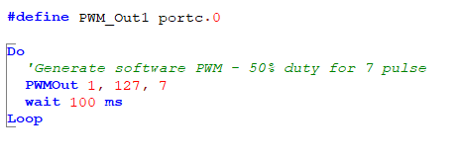
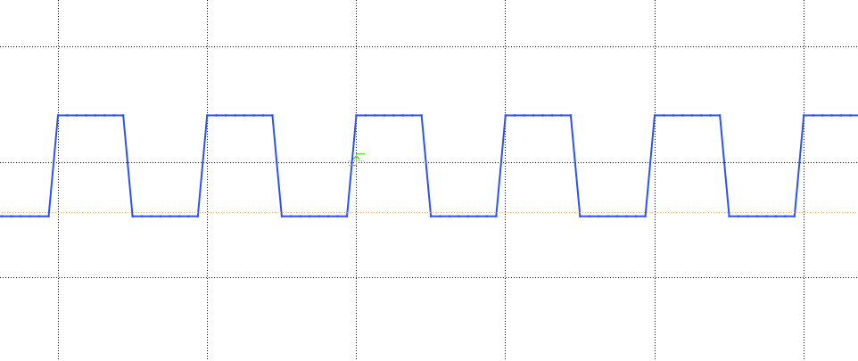
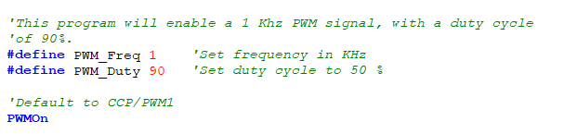
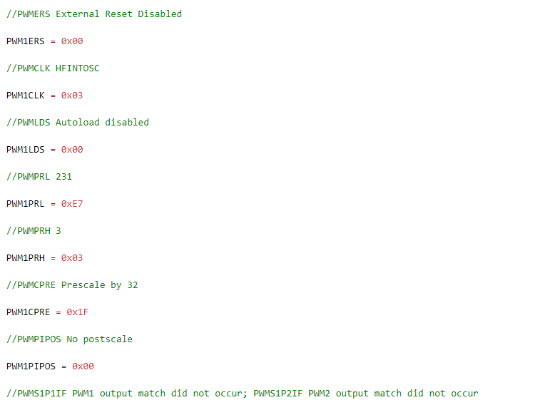
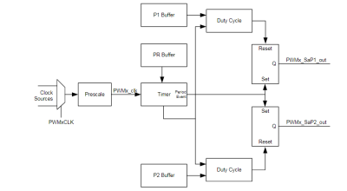
PWM

Slide 15
Videos...
Install the hardware and make the board work – three LED programs
Make four LEDs flash in a sequence
Set the LEDs to represent the value of ADC
Sequence the LEDs with a delay using the value of ADC
Using an input to set the state of the LEDs
Using the reset switch
Using the switch, ADC – the LEDs flash in a sequence with reverse
Using the serial to display values
Using the timer0 overflow, 8bit timer, 16bit timer to flash the LEDs
Using CCP/PWM to dim the LEDS
Using I2C with serial to discover I2C devices
Using EEProm – showing values on the serial terminal
Using an I2C GCLD display
Using an SPI GCLD display
Using PWM to dim the LEDS
Using memory within the PIC – Progmem and SAF memory
The Great Cow BASIC tool chain
Assembly and alternatives assemblers
Summary

Slide 16
Great Cow BASIC Part 15
Great Cow BASIC for the PIC16F171xx chip Family
Oct 2022

Slide 18
Backup Slides

Slide 19
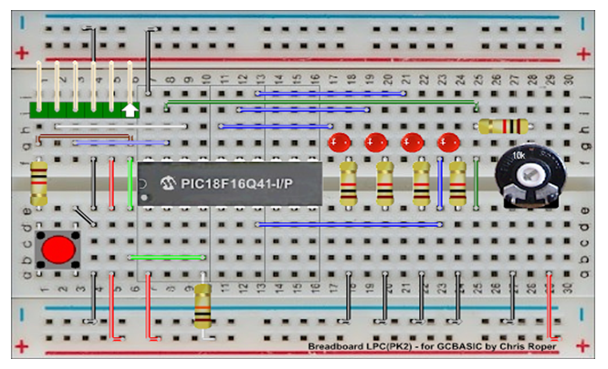
PWM

